Slide 1
ESCAP/WMO Typhoon Committee 18th Integrated Workshop/4th TRCG FORUM
28 November – 01 December 2023, ESCAP Conference Center, Bangkok Thailand
Advancing the Prediction of Rapid Intensification Typhoons
Seonghee Won, Hyemin Lee, Hyunsoo Lee
National Typhoon Center / KMA

Slide 2
CONTENTS
Motivation
Characteristics of RI in WNP
Data and Methods
Construction of the prediction model
Validation of Accuracy
Prediction Results
Summary and Conclusion

Slide 3
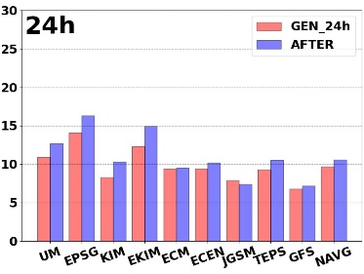
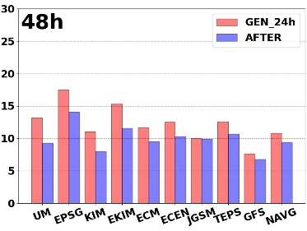
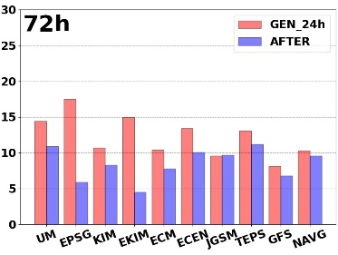
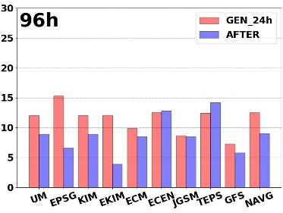
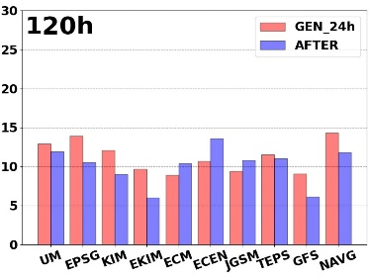
1. Motivation
Some TCs undergo rapid intensification (RI) and develop to stronger. RI is classified as the development of more than 30 kt (15 m/s) within a 24-hour period (Kaplan and DeMaria, 2003).
Rapidly intensifying TC often develop during their early stages, which can cause significant damage, so early forecasting is crucial.
Guidance for predicting the probability of RI was developed by NTC in 2023. This study focuses on predicting environmental factors during RI.
Intensity prediction error of NWP during the early period (within 24 hours after development) is larger than that of the entire period.

Slide 4
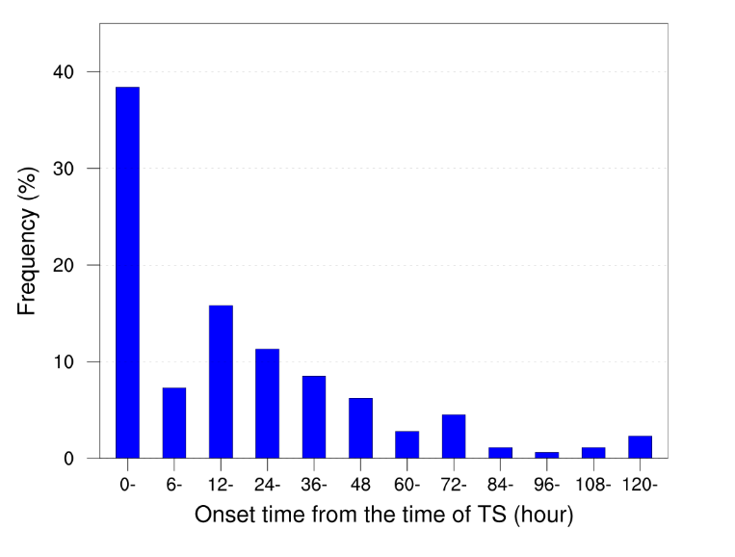
2. Characteristics of RI in WNP
Frequency of RI typhoons
During 1991 ~ 2022, more than 40% of typhoon cases are in the range of 0≤∆V24≤10 kt within 24-hour intensity change distribution.
Threshold of RI, 30 kt is defined as the 96th percentile of the cumulative probability distribution.
The onset of RI cases most often begins within 24 hours after upgraded to TS.
JMA Best Track ( 1991-2022 )

Slide 5
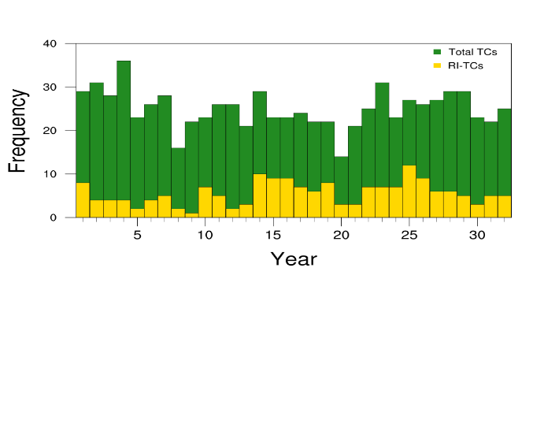
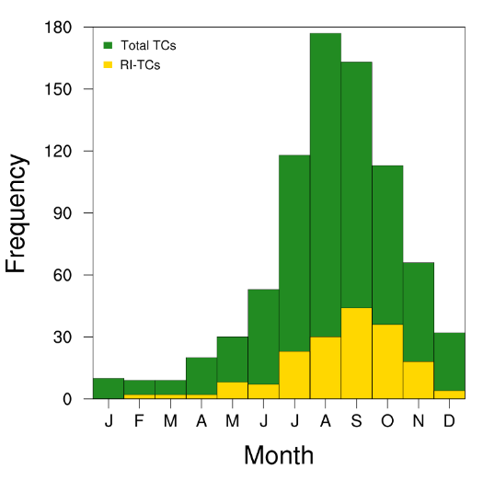
2. Characteristics of RI in WNP
Frequency of RI occurrences by year & month
Druing 1991~2022, 178 cases out of 800 typhoons rapidly intensified (RI) (22.3%), highest rate in 2015 (44.4%).
RI occurs in any season, including in December. In September & October, high frequency of RI(45.5%), while May has fewer TC but high rate of RI (26.7%).
JMA Best Track ( 1991-2022 )

Slide 6
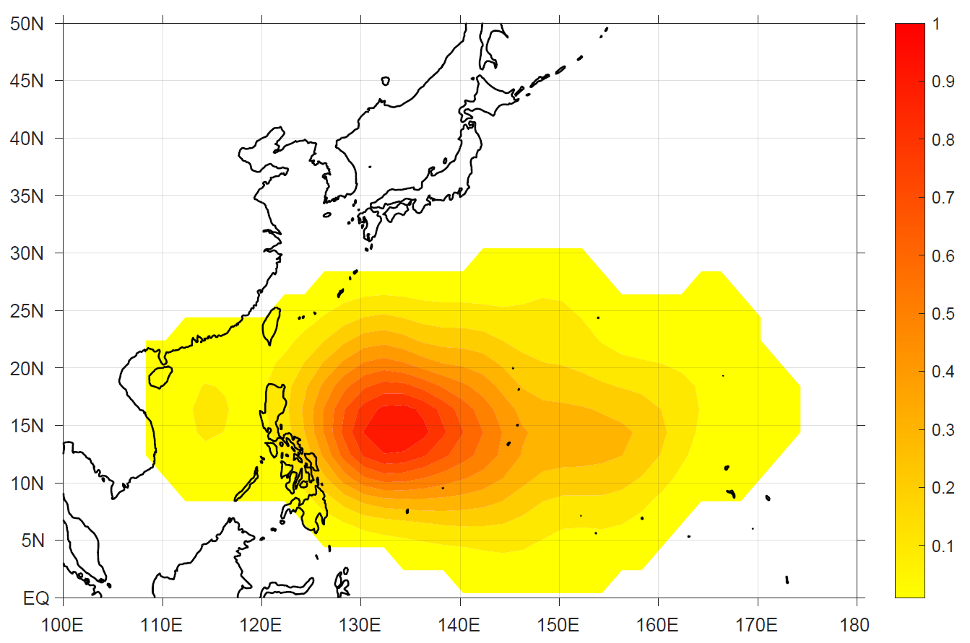
2. Characteristics of RI in WNP
Distribution of RI typhoons
RI typhoons typically occur in the eastern part of the Philippines (10-20˚N, 125-145˚E) and rarely in the northern area above 25˚N, including the South China Sea.
JMA Best Track ( 1991-2022 )

Slide 7
3. Data and Methods
Period and Data
 | Period | Number of cases | Data
Training | 2011~2020 June - November | (RI) 56 cases (non RI) 170 cases | (Atmospheric) ERA-5 (Oceanic) HyCOM, CFS V2, NOAA OISST (TC information) RSMC best track
Validation | 2021~2022 June – November | (RI) 6 cases (non RI) 34 cases | (Atmospheric) ECMWF (Oceanic) GloSea6 (TC information) KMA best track
Methodology
(Logistic regression) Algorithm that predicts the probability of data falling into a category with a value between 0 and 1, and then categorizes it into that class if the probability is greater than or equal to 0.5 for the rapid intensification of a typhoon.
$$p= \frac{1}{1+exp⁡(β_{0}+β_{1}χ_{1}+β_{2}χ_{2}+⋯β_{k}χ_{k})}$$
$p$ : probability of RI
$β_{0}$ : intercept
$β_{k}$ : coefficients
$χ_{k}$ : predictors

Slide 8
4. Construction of the Prediction Model
Predictor Candidates ( Influencing Factors)
Variable | Description | Variable | Description
VMX | Maximum wind speed | DIV | 200 hPa divergence (r = 0-500 km)
$∆$VMX | Previous 6, 12, and 24h change in intensity | CONV | 850 hPa convergence (r = 0-500 km)
LAT | Latitude | VORT | 850 hPa relative vorticity (r = 0-500 km)
LON | Longitude | TCHP | Tropical cyclone heat potential (r = 0-800 km)
R30 | Radius of 30 kt wind | SST | Sea surface temperature (r = 0-800 km)
SPD | Translational speed | MPI_{h} | Maximum potential intensity (r = 0-200 km)
VWS | 200-850, 500-850 hPa vertical wind shear (r = 200-800 km) | DAT_{h} | Depth –averaged temperature (r = 0-200 km)
EPT | 200, 300, 500, 700, 850, 925 hPa equivalent potential temperature (r = 0-300 km) | POT_{h} | Potential intensity (r = 0-200 km)
RH | 300-500, 500, 500-700, 700-850, 850 hPa relative humidity (r = 200-800 km) | NGR_{h} | Net energy gain rate (r = 0-200 km)
h = 10, 20, 30, … , 120 m

Slide 9
4. Construction of the Prediction Model
NGR (thermodynamic Net energy Gain Rate)
Based on the MPI with the variation of the wind stress coefficient with wind speed and the depth averaged temperature, the thermodynamic net energy gain rate.
G is the rate of energy gained by typhoons and D is the rate of energy lost by typhoons. Tropical Cyclone reach their maximum intensity when G = D. TCs will develop if G > D, and weaken if G < D (Lee et al., 2019).
$$NGR=G_{DAT}−D_{w}=\frac{DAT−T_{o}}{T_{o}}C_{k}ρV_{s}\left(k_{0}^{∗}−k\right)−C_{d}ρV_{s}^{3}$$
energy budget = Energy input - Frictional dissipation
$$G_{DAT}=\frac{DAT−T_{o}}{T_{o}}C_{k}ρV_{s}\left(k_{0}^{∗}−k\right)$$
$$D_{w}=C_{d}ρV_{s}^{3}$$
Energy input
Frictional dissipation
NGR >0 ➔ more energy for TC intensification
NGR <0 ➔ less energy for TC intensification

Slide 10
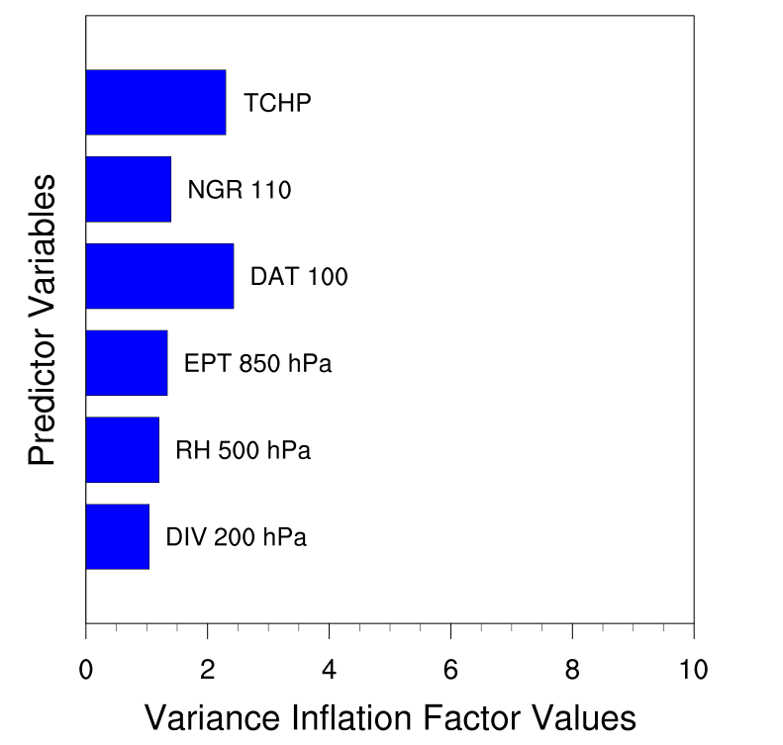
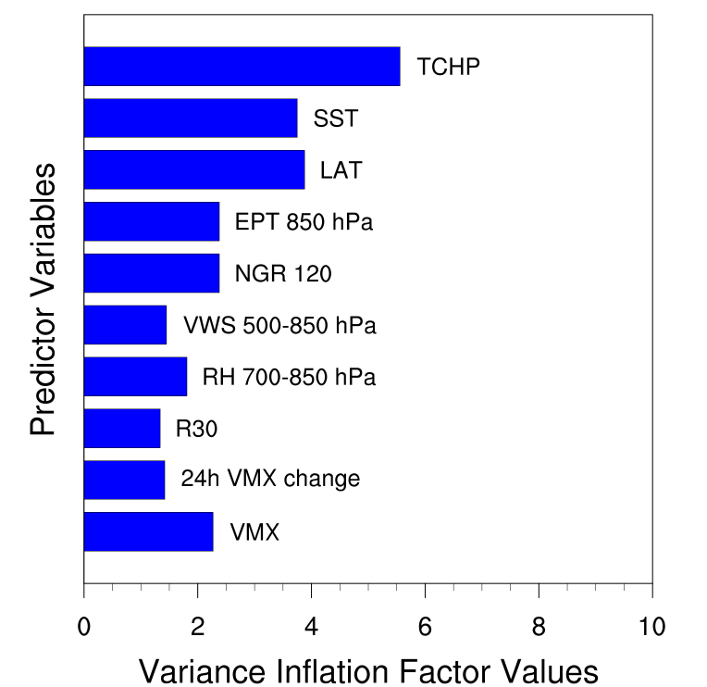
4. Construction of the Prediction Model
Statistical-based Prediction Model for the probability of typhoon RI
Predictor is constructed with different variables for each stage( forecast TD, Tropical Storm)
$$p_{fTD }=intercept+c_{1}×DIV+c_{2}×{RH}_{500}+c_{3}×{EPT}_{850}+c_{4}×{DAT}_{100}+c_{5}×{NGR}_{110}+c_{6}×TCHP$$
$$p_{TS }=intercept+c_{1}×VMX+c_{2}×∆{VMX}_{24}+c_{3}×R30+c_{4}×{RH}_{700−850}+c_{5}×{VWS}_{500−850}$$
$$+c_{6}×{NGR}_{120}+c_{7}×{EPT}_{850}+c_{8}×LAT+c_{9}×SST+c_{10}×TCHP$$
$$c_{1\sim 10} :coefficient$$

Slide 11
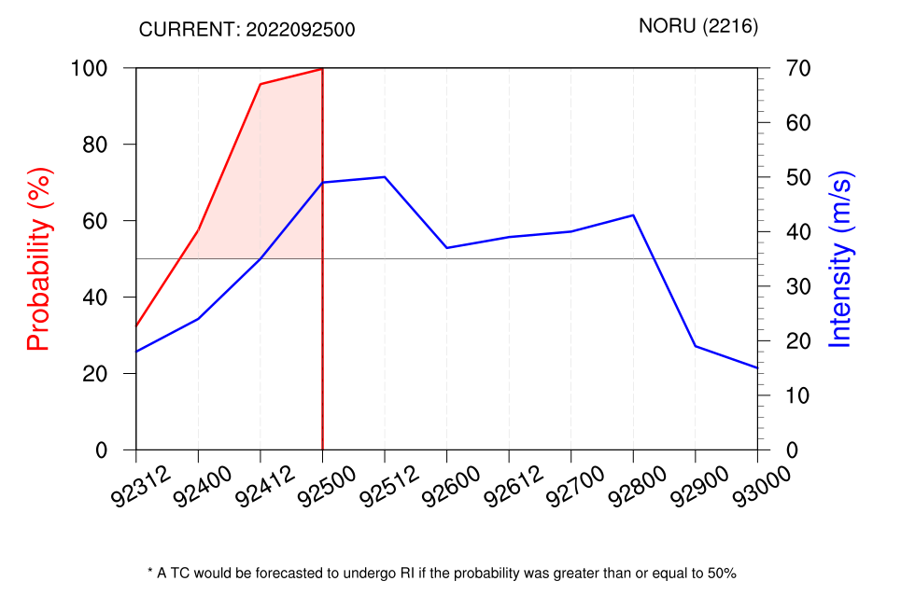
4. Construction of the Prediction Model
NTC/KMA developed an Statistical-based prediction Model for the probability of typhoon RI, and the model produces probability of RI two time a day (00UTC, 12 UTC) since 2023 August.

Slide 12
5. Validation of Accuracy
Example of the prediction result
For the case of RI (2211, HINNAMNOR) / Non-RI (2220, NESAT) probability forecast showed that Typhoon HINNAMNOR intensified rapidly from 06 UTC on August 28 to 06 UTC on August 30, with a high probability of intensification of more than 70%. Typhoon NESAT has a low probability of rapid intensification of about 30% or less.

Slide 13
5. Validation of Accuracy
Verification of prediction results
Training (2011~2020) |  | Prediction
 |  | positive | negative
Observation | positive | 169 | 10
 | negative | 416 | 2332
Validation (2021~2022) |  | Prediction
 |  | positive | negative
Observation | positive | 34 | 5
 | negative | 40 | 602
During training period, prediction accuracy was about 0.85. Out of the 179 rapid intensification cases, 169 were successfully predicted in advance, while 10 cases failed to be predicted.
For validation period, prediction accuracy was about 0.93, and 34 out of the 39 RI cases were successfully predicted, with 5 cases missed.
High false alarms remain a challenge that needs to be improved.

Slide 14
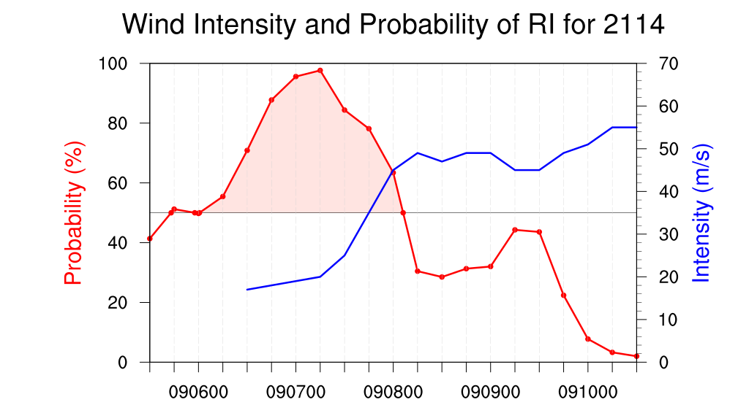
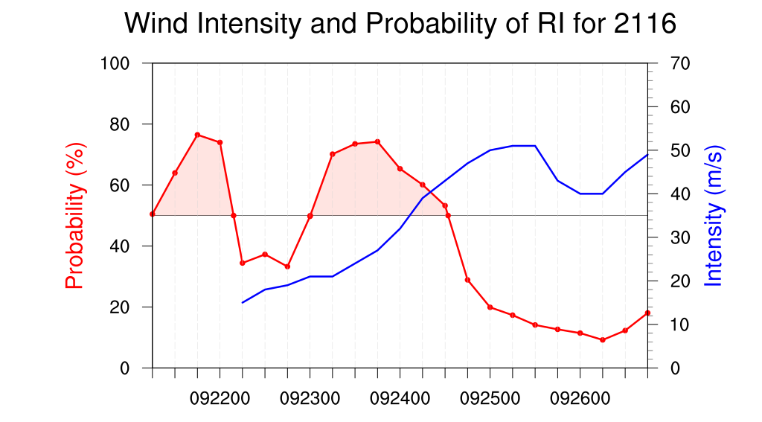
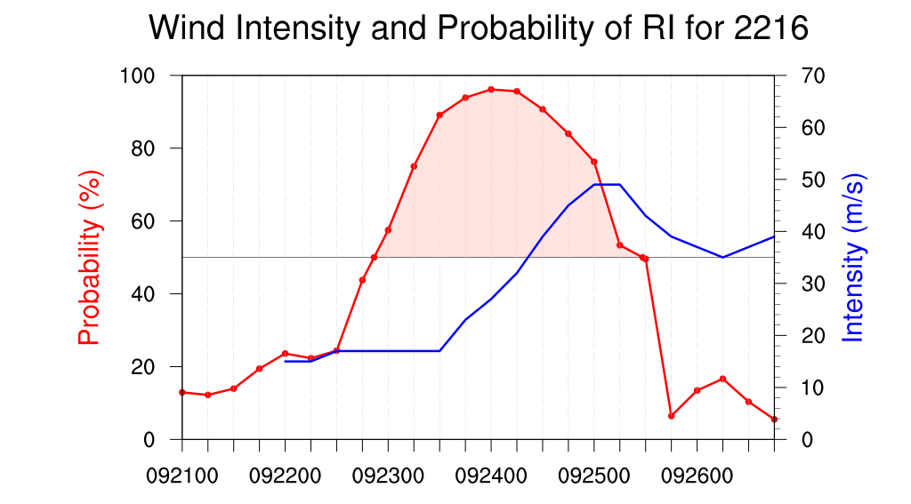
6. Prediction Results
Cases of Prediction Results
(Case 1) Typhoon predicted by rapid intensification
CHANTHU(2114), MINDULLE(2116), NORU(2216)

Slide 15
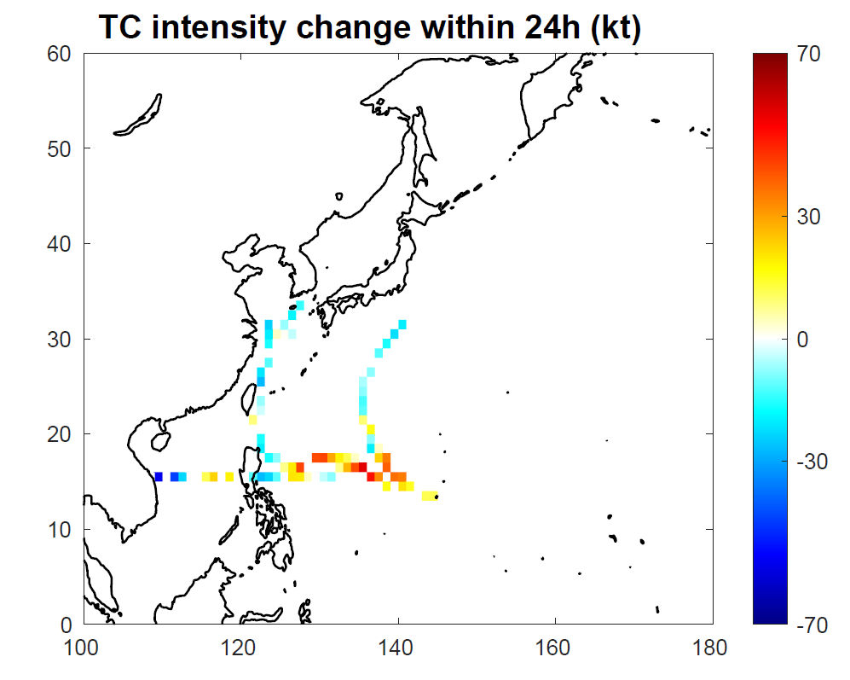
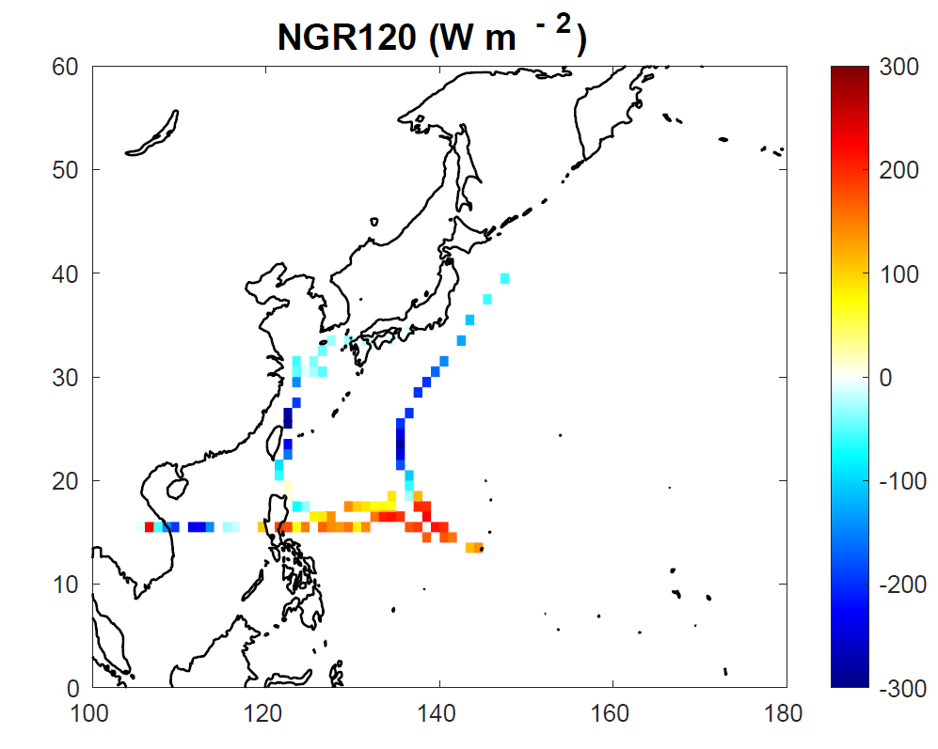
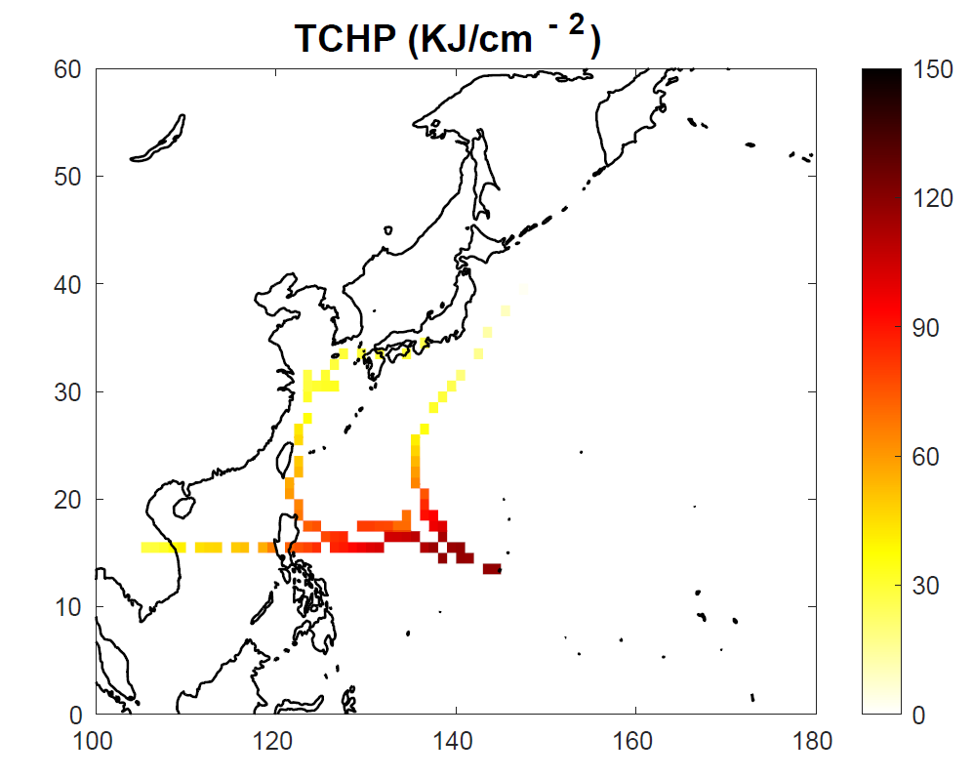
6. Prediction Results
Cases of Prediction Results
(Case 1) Typhoon predicted by rapid intensification
CHANTHU(2114), MINDULLE(2116), NORU(2216)
NGR and TCHP showed high distribution values, indicating a favorable environment for RI. High probability of RI was predicted.
2216
2114
2116

Slide 16
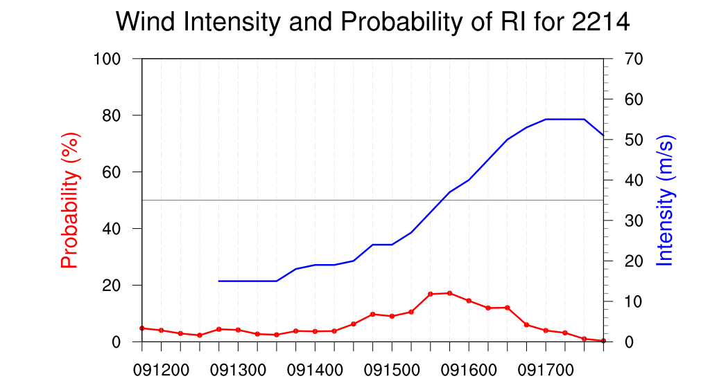
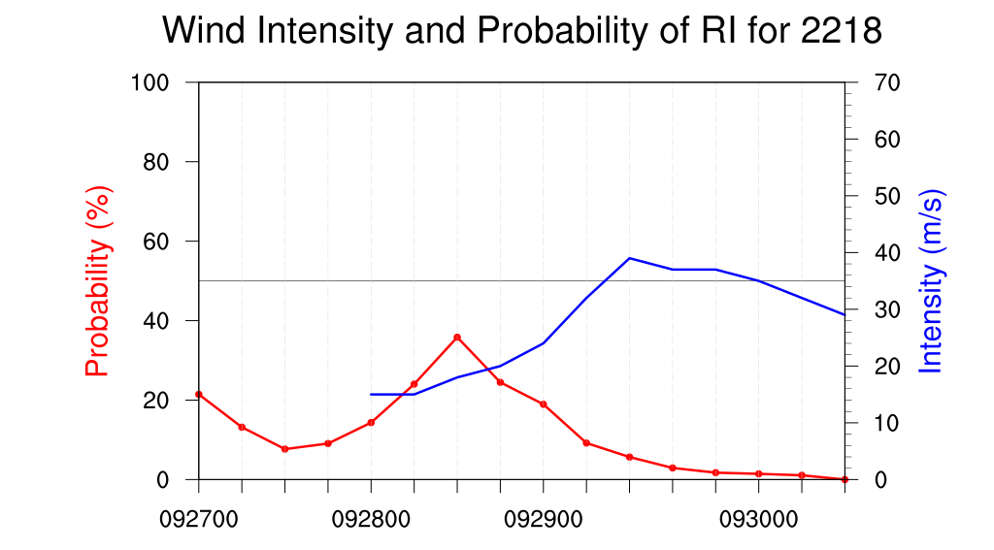
6. Prediction Results
Cases of Prediction Results
(Case 2) Missing predictions of intensification
NANMADOL(2214), ROKE(2218)

Slide 17
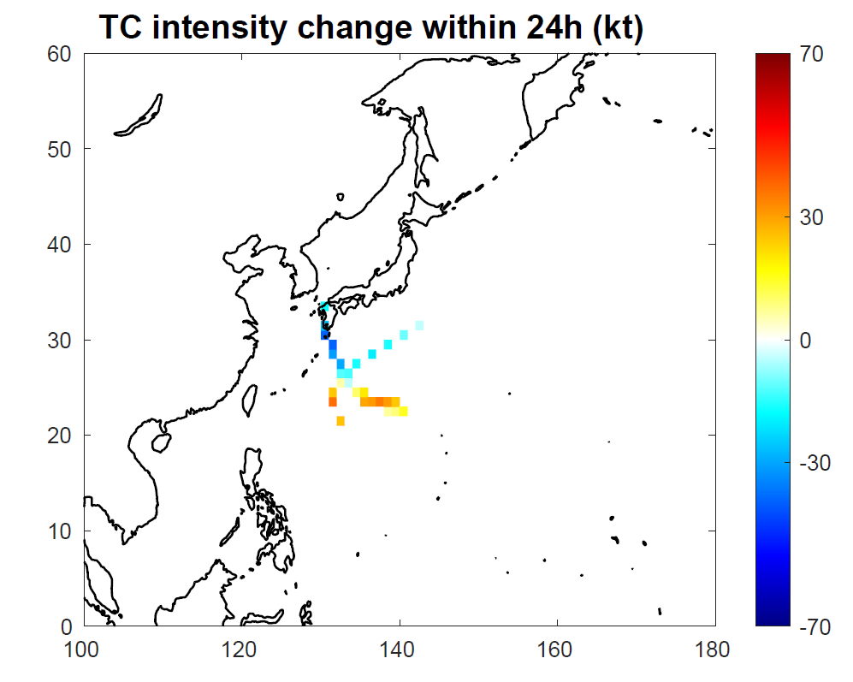
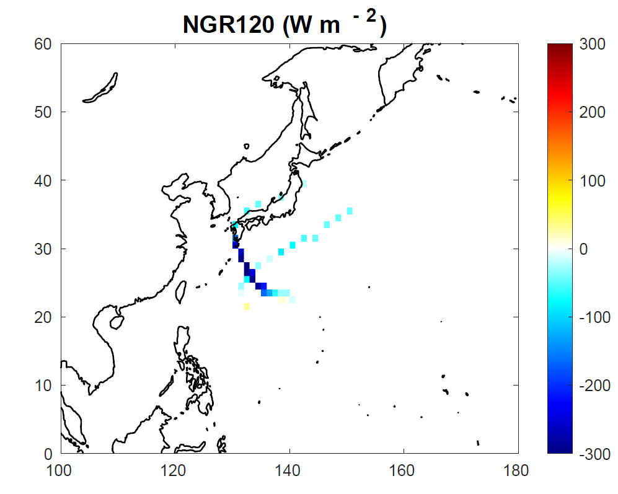
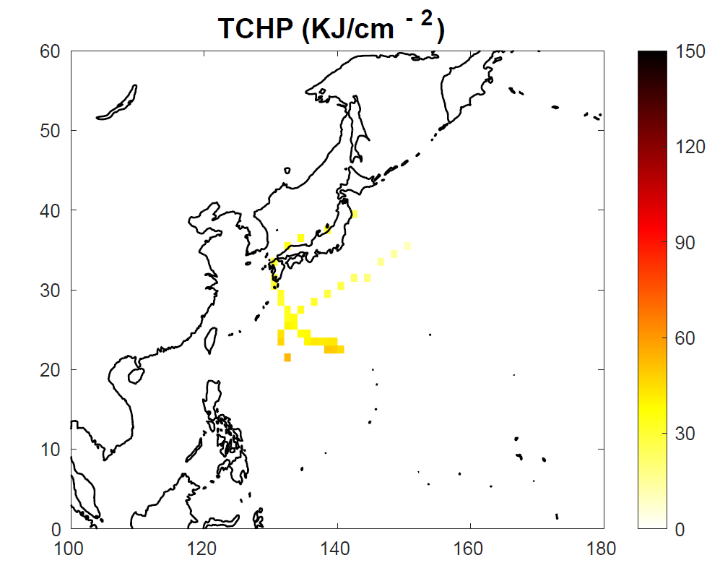
6. Prediction Results
Cases of Prediction Results
(Case 2) Missing predictions of intensification
NANMADOL(2214), ROKE(2218)
Despite low NGR and TCHP, TCs intensified even at high latitudes (25˚N). Despite unfavorable ocean conditions, But RI was caused by the strong divergence in the upper layer and high thermal conditions in the middle layer.
2218
2214

Slide 18
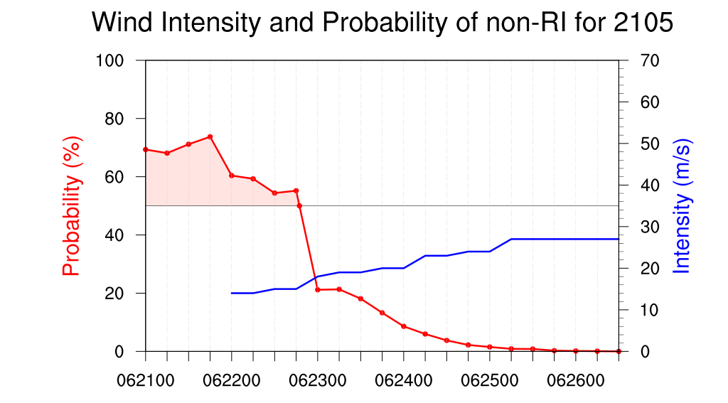
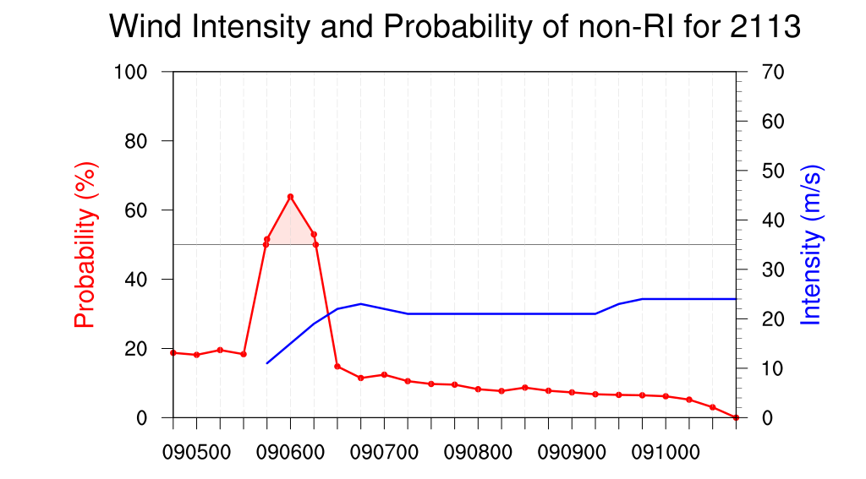
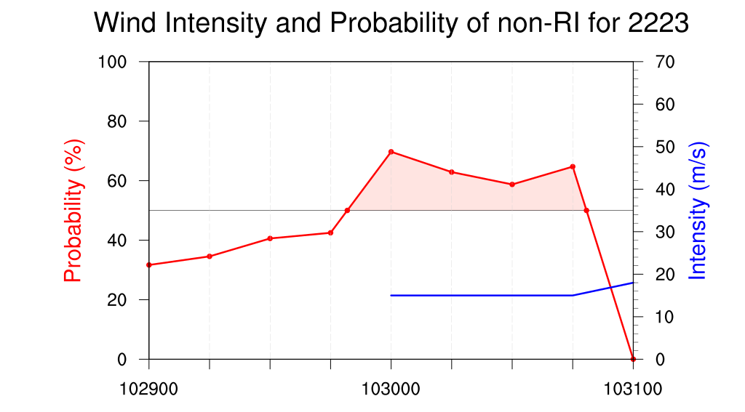
6. Prediction Results
(Case 3) False Alarm for intensification
CHAMPI(2105), CONSON(2113), BANYAN(2223)

Slide 19
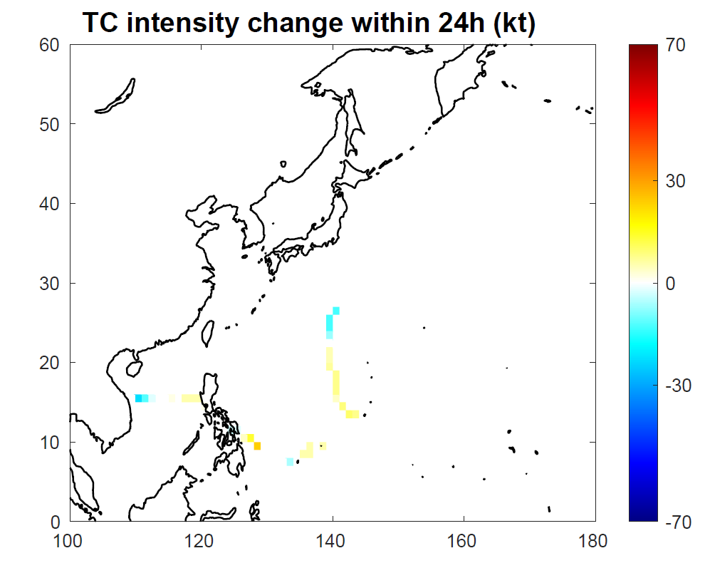
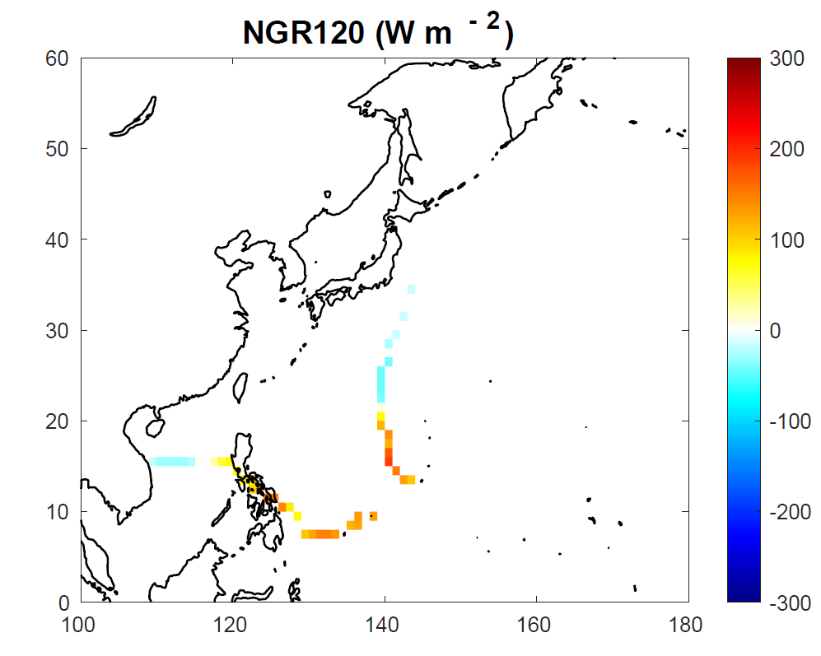
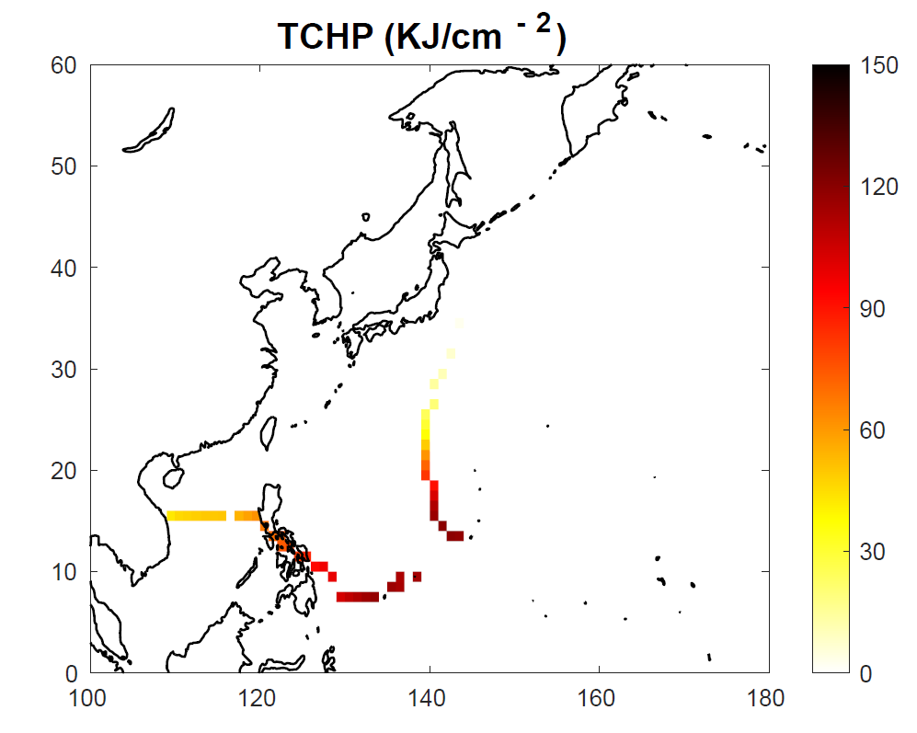
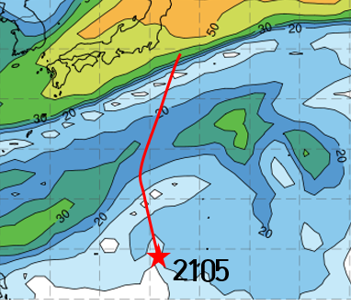
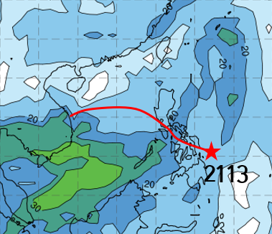
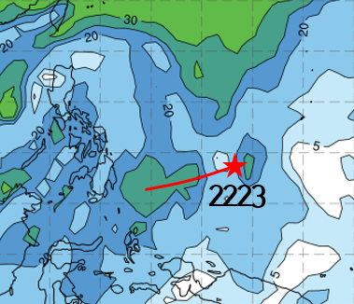
6. Prediction Results
(Case 3) False Alarm for intensification
CHAMPI(2105), CONSON(2113), BANYAN(2223)
NGR and TCHP values indicate that ocean conditions were highly favorable for RI, but no RI occurred. TC development was limited due to strong vertical wind shear in the region.
2113
2105
2223

Slide 20
7. Summary and Conclusion
For the purpose of supporting typhoon forecasting, a statistical-based prediction model for the probability of rapid intensification (RI) was developed in 2023.
The prediction accuracy of the regression model for typhoons (6 RI, 34 non-RI) was about 0.93, from 2021 to 2022. However, the presence of a high false alarms continues to be a challenge that needs improvement.
Intensified typhoons have a tendency to develop into stronger typhoons when favorable conditions are present. However, predicting these favorable conditions for RI is complex and challenging. Predictive models showed good results during the validation period, but they also had limitations, primarily due to their high dependence on oceanic conditions.
Through the additional predictors and the enhancement of the prediction model, we aim to improve the accuracy of RI probability predictions.

Slide 21
Thank you for your attention.

